Slide 1

GPU-accelerated
Cardiac Electrophysiological Simulation
CIS 565: GPU Programming and Architecture, Final Project Proposal
Zirui Zang (zzang@seas.upenn.edu) 20211025

Slide 2
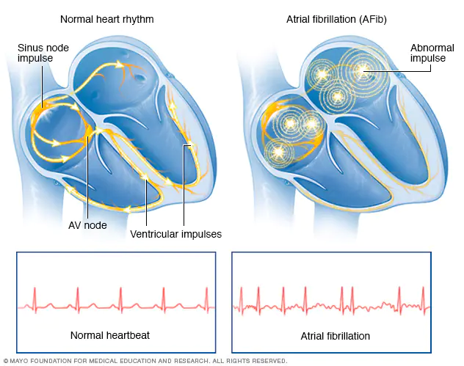
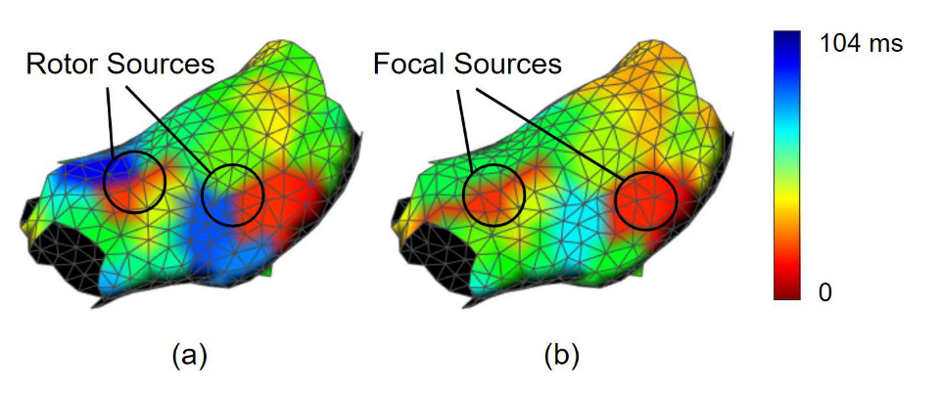
Background
In Atrial Fibrillation (AF), the heart's upper chambers beat chaotically and irregularly, out of sync with the lower chambers of the heart.
Catheter ablation is a procedure that uses radiofrequency energy to destroy a small area of heart tissue to restore regular rhythm.
However, real patients’ hearts can be complex and finding sources of irregular beating is very difficult. One approach is trying to use electrophysiological modeling to guide the doctors’ search.
Atrial Fibrillation (AF)
Finding Potential Source Locations w/ Cardiac Modeling

Slide 3
Project Structure
Preprocessed Data
Data Handler
Compute Kernels
Visualizer
Output Data
The preprocessed patient heart geometry and parameters need to be output from the current Matlab environment and imported into the C++ environment.
Compute Kernels will take in the parameter and have functions to solve the ODEs and PDEs associated with the Mitchell-Schaeffer model using the Euler’s method.
A visualizer will visualize the output from the model.

Slide 4
Simulation Demo 1
2 point stimulus in an atrium
Color shows the propagation of electric signal inside the tissue.

Slide 5
Simulation Demo 2

Slide 6
Speed Comparison
 | Matlab | C++ Eigen | GPU Win10 | GPU Linux | GPU Linux float
time(s) | 140 | 37 | 2.0 | 0.66 | 0.5
speed vs. | 1x | 3.8x (1x) | 70x (18.5x) | 212x (56x) | 280x (74x)
Interesting finding: Same code compiled on Linux runs 3x faster. (Code is compiled in release mode on Windows)
CPU: Ryzen 3700x, GPU: RTX2070s

Slide 7

Testing on Other Platforms
Tested the simulator in three different platforms:
Server platform w/ RTX A6000 GPU (x64 Linux compile)
Workstation platform w/ RTX 2070s GPU (x64 Windows compile)
Embedded platform w/ Nvidia Jetson Xavier NX (Arm Linux compile)
 | Server (float) | Workstation (float) | Jetson (float)
time(s) | 0.5 (0.5) | 0.66 (0.5) | 7 (6)
* Code is dockerized and compiled on server.

Slide 8
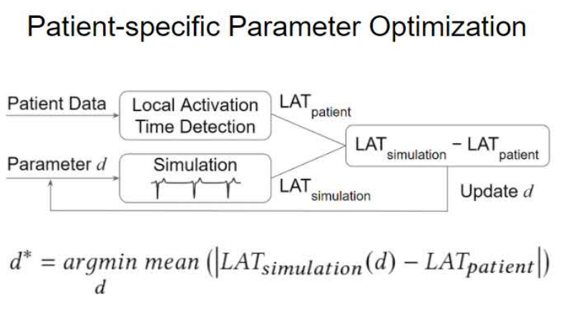
Further Plan
With the new tool, we are planning to extend the project to create an auto-tuner for patient specific cardiac modeling. Expected to publish early next year.
This loop just got from 140 sec to 0.6 sec!

Slide 9
References
https://towardsdatascience.com/parallel-computing-upgrade-your-data-science-with-a-gpu-bba1cc007c24
https://www.mayoclinic.org/diseases-conditions/atrial-fibrillation/symptoms-causes/syc-20350624
https://www.heart.org/en/health-topics/arrhythmia/prevention--treatment-of-arrhythmia/ablation-for-arrhythmias
J. He, A. Pertsov, S. Dixit, K. Walsh, E. Toolan, and R. Mangharam, “Patient-specific heart model towards atrial fibrillation,” in ICCPS 2021 - Proceedings of the 2021 ACM/IEEE 12th International Conference on Cyber-Physical Systems (with CPS-IoT Week 2021), May 2021, pp. 33–43, doi: 10.1145/3450267.3450532.

